Slide 1


Own Your Mortgage
Your home may be repossessed if you do not keep up repayments on your mortgage.

Slide 2
About Us
Own Your Mortgage has been providing customers advice on mortgages, adverse credit and protection and insurance.
Own Your Mortgage is a local run business based in Wolverhampton and has been established over <number of years>, not only helping to assist you in purchasing your dream home, but also helping to ensure that you can stay there no matter what life puts in your way.
We are fully CeMAP qualified (Certificate in Mortgage Advice and Practice) and have access to a comprehensive range of options, to help you find the most suitable product depending on your individual needs and circumstances. We will aim to handle the process as smoothly as possible, to help you move forwards with confidence.
We have extensive experience of Residential Mortgages, Buy To Let Mortgage and Protection & Insurance
Our aim is to assist you through the minefield of locating the right mortgage for your dream home AND protection product to help make sure you can stay in your dream home no matter what happens.
The reason I consistently get reviews from my clients is simple – I genuinely care about all my clients who turn into long term friends. I know that if you’re happy, I have done my job well.
INSERT PICTURE OF ADVISER/ADVISER’S HERE
In preparation I thought you may like to watch this short video, which will explain how to get the most out of our meeting, you can watch the video <INSERT LINK’S TO VIDEO’S>.
Own Your Mortgage

Slide 3
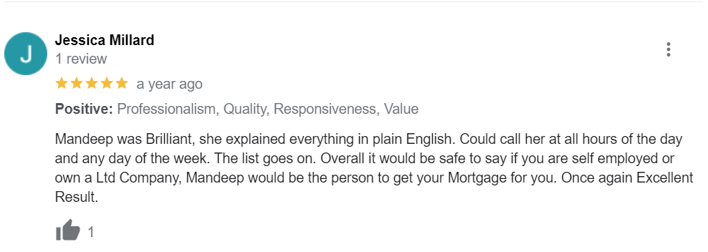
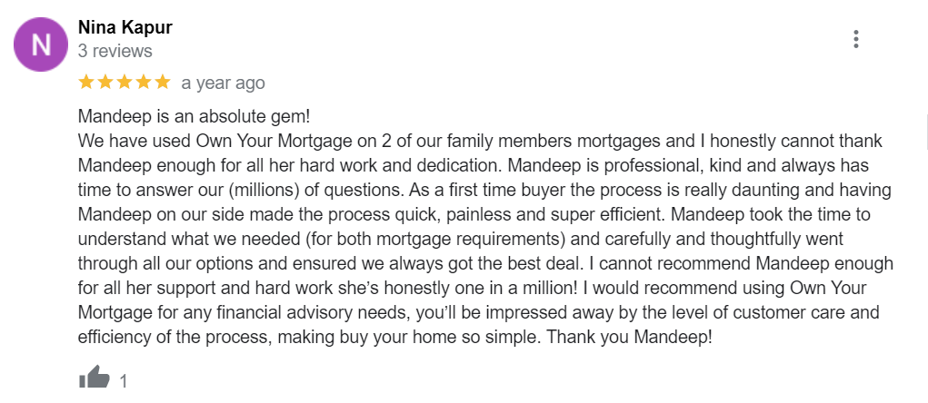
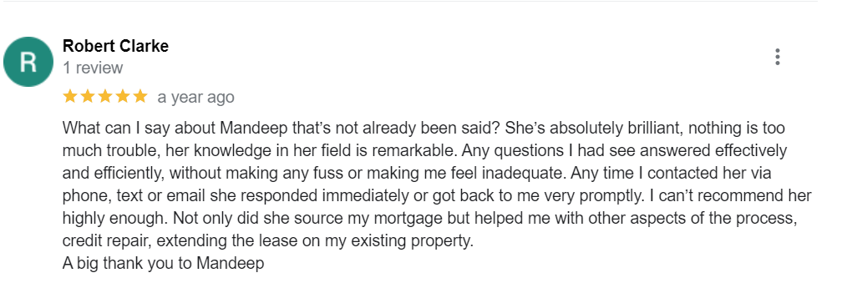
Testimonials
Own Your Mortgage

Slide 4
How I can help you in 3 easy steps
1.
I will listen to you to fully understand how I can assist you in securing the most appropriate mortgage for your needs and requirements.
2.
I will prepare plans to ensure you can remain in your home no matter what life puts your way securing your financial future.
3.
Finally I will present my advice and recommendations to you so you can make an informed decision on the right mortgage for you, as well as the necessary plans which will help to shield you against unforeseen risk.
Own Your Mortgage

Slide 5

To get started
If you’re seeking a mortgage, please supply me with the following information;
ID/Proof of Address
Last 3 months pay slips, if employed
Last 3 years SA302s and overviews, if self-employed
Last 3 months bank statements
Latest mortgage statement, if you have a current mortgage
If you’re seeking protection insurances, please supply me with the following information;
Your company sick pay entitlement
Your death in service benefit
My contact details are as follows;
Mobile: 07523122739
Email address: mandeep@ownyourmortgage.co.uk
Your home may be repossessed if you do not keep up repayments on your mortgage.
Own Your Mortgage

Slide 6

Your home may be repossessed if you do not keep up repayments on your mortgage.
Broker fee disclosure
There maybe a fee payable for mortgage advice.
Jurisdictional statement
The guidance and/or information contained within this website is subject to the UK regulatory regime and is therefore targeted at consumers based in the UK.
Mortgage risk statement
Your home may be repossessed if you do not keep up repayments on your mortgage.
Mandeep Meetcha, trading as Own Your Mortgage, is an Appointed Representative of HL Partnership Limited which is authorised and regulated by the Financial Conduct Authority.
There may be a fee payable for mortgage advice. The precise amount will depend upon your circumstances.
HLP CG MP001 08/22

