Slide 1



Wills and Estate Planning
HL Wills, are here solely to provide you,
HLP advisers, with a cost-effective, efficient and friendly will writing service for your clients.
Accredited member of
The Society of Will Writers

Slide 2

Making a Will is one of the most important decisions you will ever make...
Nobody hopes for the worst…
but you can prepare for it.

Slide 3
Who are HL Wills…?
Accredited member of
The Society of Will Writers
Efficient and friendly will writing service for your clients.
Member of the Society of Will Writers.
Over 30 years of Wills and Estate Planning experience.
Independent and fully insured.
Nationwide coverage (excluding Scotland).
Can provide telephone and face to face appointments.
Cover all varieties of Wills and Estate Planning including Will Trusts/Business Trusts and Lasting Power of Attorney.

Slide 4

The HL Wills Process
Client details passed to HL Wills by HLP Advisors
HL Wills team contacts the client to book appt
Instructions taken and payment taken
Pre-appointment email sent to client
Will drafted and emailed to client
Draft approved by client
Final Will posted to client for signing/witnessing
Client returns original Will/s for storage if taken

Slide 5


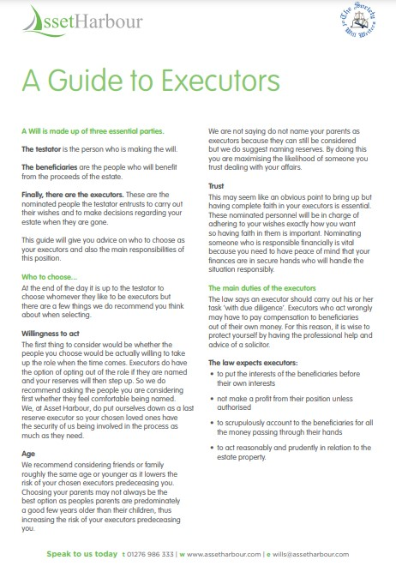
Why I do need a Will… and who’s important?

Slide 6



Trusts and LPA’s … a client’s expectation

Slide 7




The HL Wills Cycle …
Potential new Clients require IHT Tax Planning and WOL Insurance.
Client details passed
to HL Wills having expressed an interest in a Will.
Client provides names of Guardians, Executors and Trustees (subject to GDPR consent).
HL Wills contacts Client and progresses Will instruction.

Slide 8
Will and Estate Planning Price List
Accredited member of
The Society of Will Writers
Single Will - £149
Mirror Will - £249
Protective Property Trust - £389 / £499
Vulnerable Persons Trust - £299
Business Protection Relief Trust - £299
Discretionary Trust - £299
Children’s Trust - £299
*All prices are excluding VAT

Slide 9
Will and Estate Planning Price List
Accredited member of
The Society of Will Writers
Tenancy Severance - £199
Pilot Trust - £695
LPAs x1 (Property/Finance or Health/Welfare) - £299
LPAs x2 (Property/Finance and Health/Welfare) - £499
LPAs x4 (Property/Finance and Health/Welfare) - £699
Lifetime Storage - £99
Amendments per document - £49 / £69
*All prices are excluding VAT

Slide 10
Bringing will writing into
the 21st Century
Next Steps ...
Telephone: 0808 275 8955
Email: info@hlwills.co.uk

